Slide 1
PoE Calculator V3
Instructions
Matthias Gerber, Market Manager LAN Cabling
January 2022

Slide 2
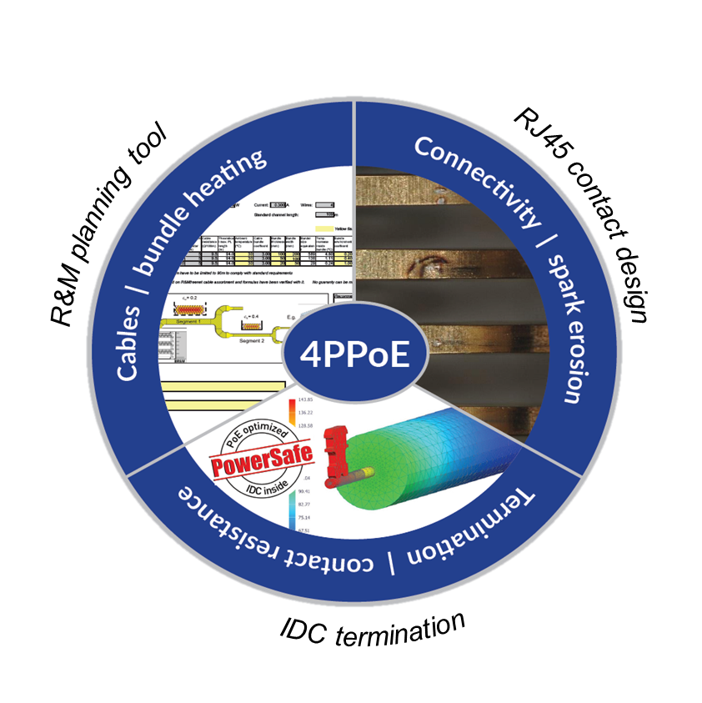
Overview PoE requirements
New PoE applications with continuous
high-power demands change cabling requirements
Planning, installation and product selection
must be in line for 4PPoE support
Cable runs must take the increased attenuation of the DC power delivering heated cables in cable bundles into account
Contact designs are optimized to minimize
the effects of spark erosion
To ensure long term 4PPoE support, reliable wire termination technologies like IDC must be used.
PowerSafe products should be specified
Notes:
The wheel represents the 3 topics that have to be controlled to ensure 4PPoE support
Remote Power Categories are the standards way to control the Cables / Bundle Heating section

Slide 3
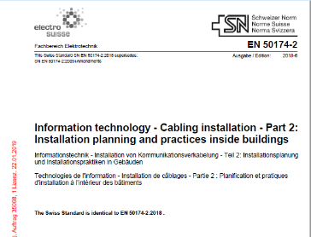
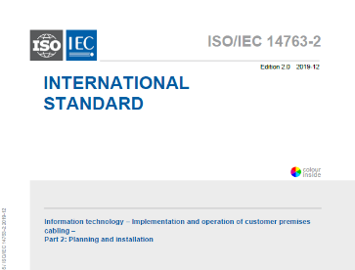
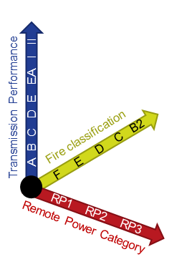
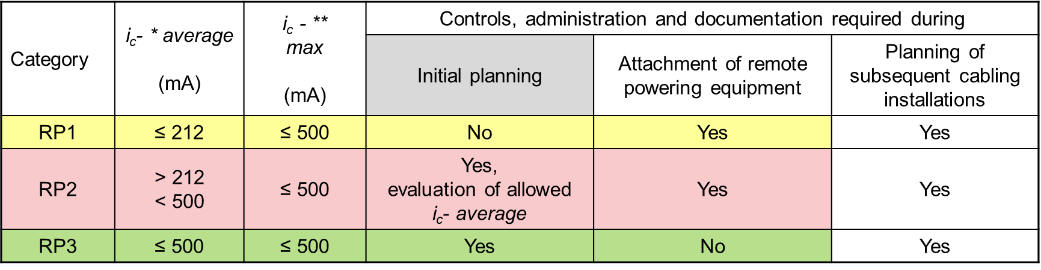
Introducing: Remote Power Category (RP1 – 3)
Installation standards ISO/IEC 14763-2 & EN 50174-2 specify and require the
RP Categories for all structured cabling
The RP categories define the allowed average DC-power in a cable bundle: RP1 < 212 mA, RP2: 212 - 499 mA, RP3 > 499 mA
The maximum DC-power on a single conductor is 500 mA for all categories
RP Categories are an independent dimension in addition to transmission performance (e.g. Class E_{A}) or Fire Class (e.g. CPR C_{ca})
Notes:
RP categories are a requirement to confirm with ISO/IEC 11801 and EN 50173 standards
RP categories deal with requirements of the complete installation, not a single link
The Ic average is calculated as power average, i.e. RMS (Root Mean Square) of current
RP categories are a new dimension to caracterize a cabling installation, adding to the complexity
A cable bundle in this context means a number of cables bunched together, e.g. in a cable tray

Slide 4
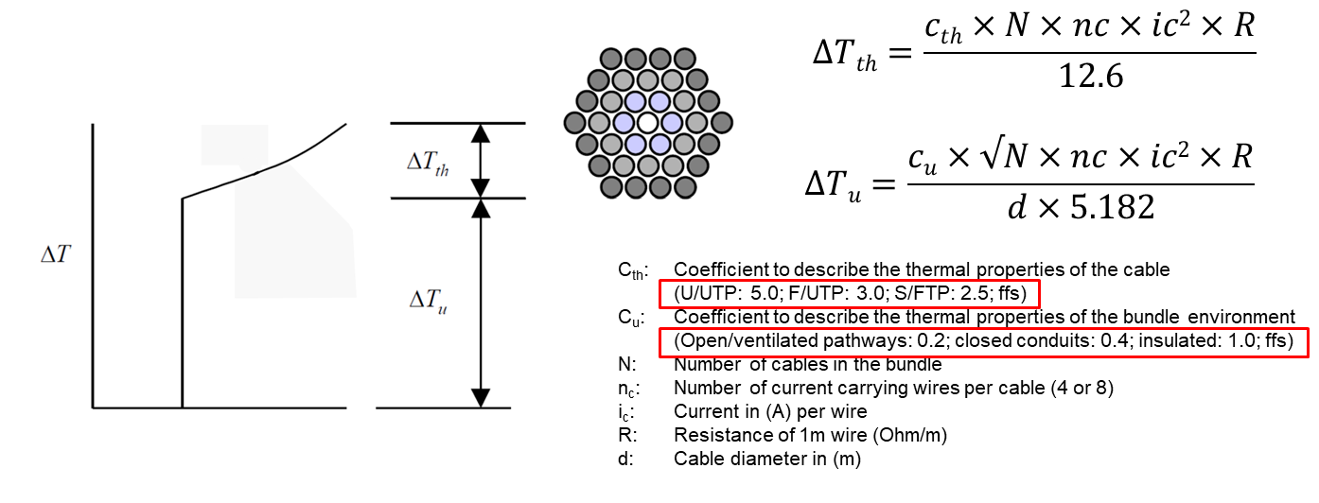
Temperature Calculation in Cable Bundles
Multiple standardization committees published documents on the problem
(ISO/IEC SC25: TR 29125, Cenelec TC215: EN50174-99-1, TIA)
C_{th}: Coefficient to describe the thermal properties of the cable
U/UTP: 5.0; F/UTP: 3.0; S/FTP: 2.5
C_{u}: Coefficient to describe the thermal properties of the bundle environment
Open/ventilated containment: 0.23; closed conduit: 0.48; insulated: 1.1
N: Number of cables in the bundle
n_{c}: Number of current carrying wires per cable (4 or 8)
i_{c}: Current in (A) per wire
R: Resistance of 1m wire (Ohm/m)
d: Cable diameter in (m)
Notes:
ISO/IEC 14763-2 and EN 50174-2 are using calculation formulas established in ISO/IEC TR 29125.
A cable bundle dissipates heat from the surface of the bundle to the environment (hull temperature)
Additionally, the temperature increases from the outside to the inside of the bundle for each layer of cable

Slide 5
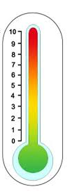
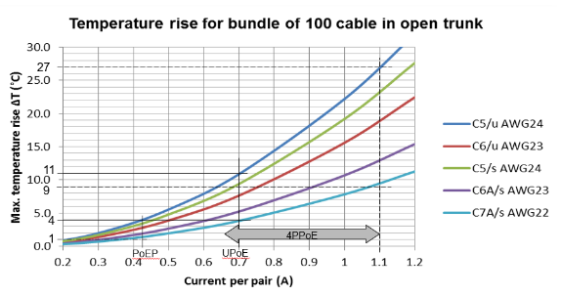
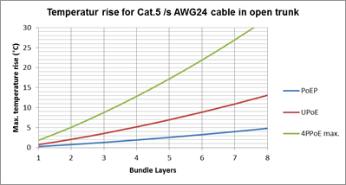
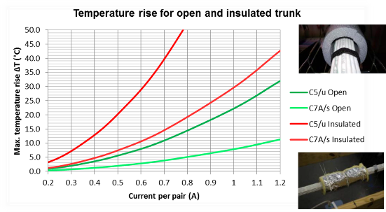
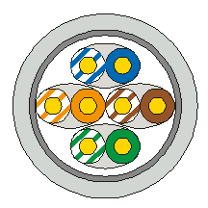

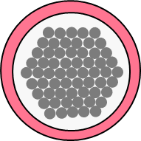
PoE Basics
Current flowing in cable generates heat due to the resistance of the copper
If heat cannot escape, temperature in the cable rises
Higher cable temperature leads to higher attenuation
Attenuation budget for application may be exceeded
In this case, cabling length has to be reduced
The bigger the current, the higher the temperature
The bigger the bundle, the higher the temperature
The better ventilated, the lower the temperature
Notes:
Show causal chain from current flowing to high temperature to increased attenuation and therefore disrupted data transmission
Influence of cable construction: more current – higher temp, more copper – lower temp, shielded cable - lower temp
Influence of bundle size: more layers of cables in a bundle – more temp
Influence of environment: the easier the heat dissipation from the bundle to the environment – lower temp

Slide 6
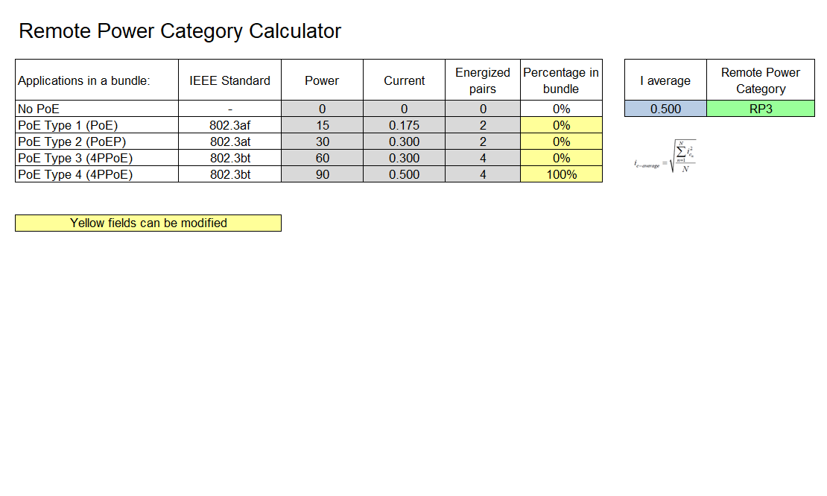
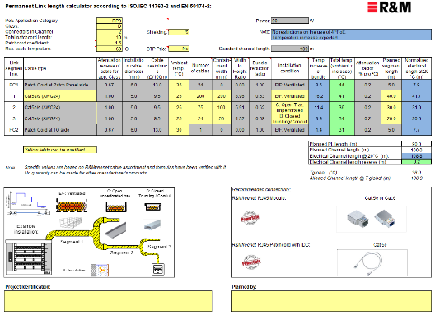
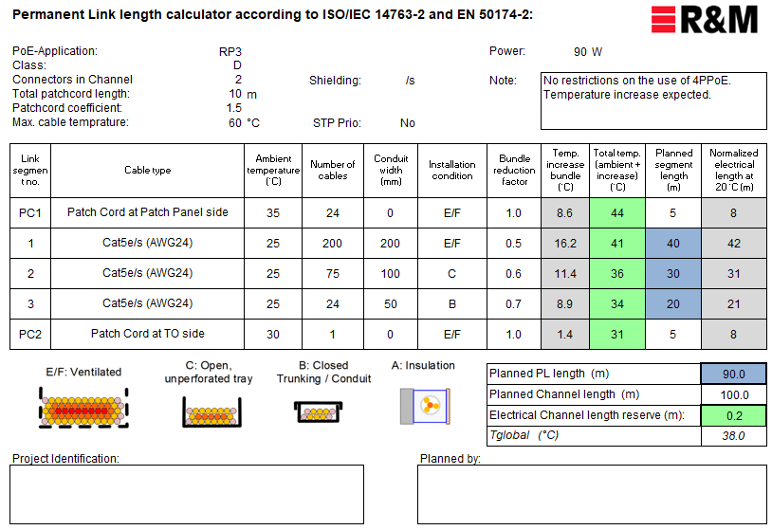
R&M PoE Calcualtor V3
3 page Excel Spreadsheet (Download here)
«RP Category Calculator»:
Calculates required RP category based on PoE application
«Link Length Calculator»:
This is the active user interface (yellow fields for input)
«Printout»:
Condensed version of the results for documentation
RP Category Calculator
Link Length Calculator
Printout
Notes:
R&M PoE Calculator helps to simulate a link behavior in different circumstances

Slide 7
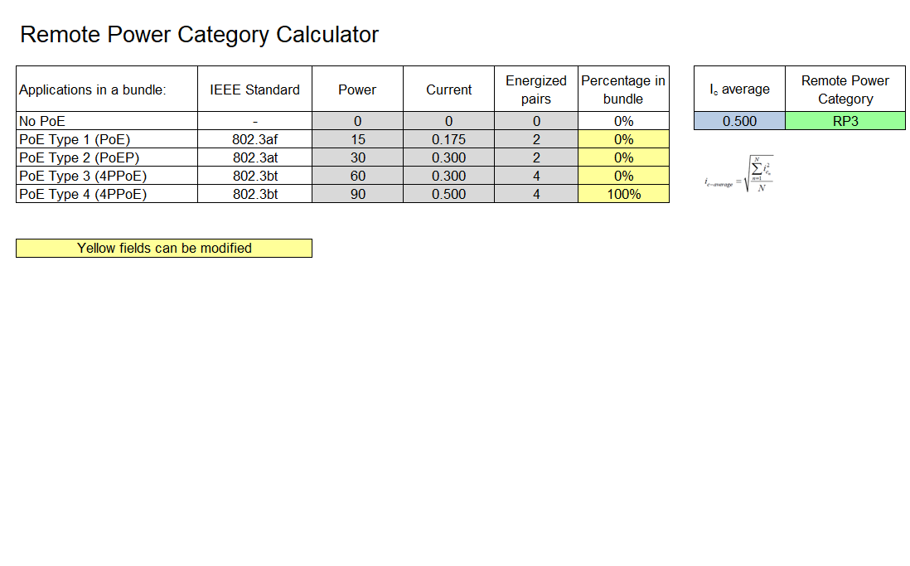
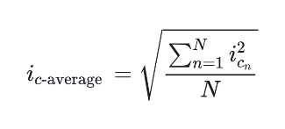
RP Category Calculator
Input worst case PoE application mix
100% max possible
I_{c}-average will be calculated
From I_{c}-average the required RP category will be determined
Notes:
Ic average is a RMS (Root Mean Square) calculation → Higher currents are higher weighted as smaller ones
Future changes of PoE application mix should be considered during the input

Slide 8
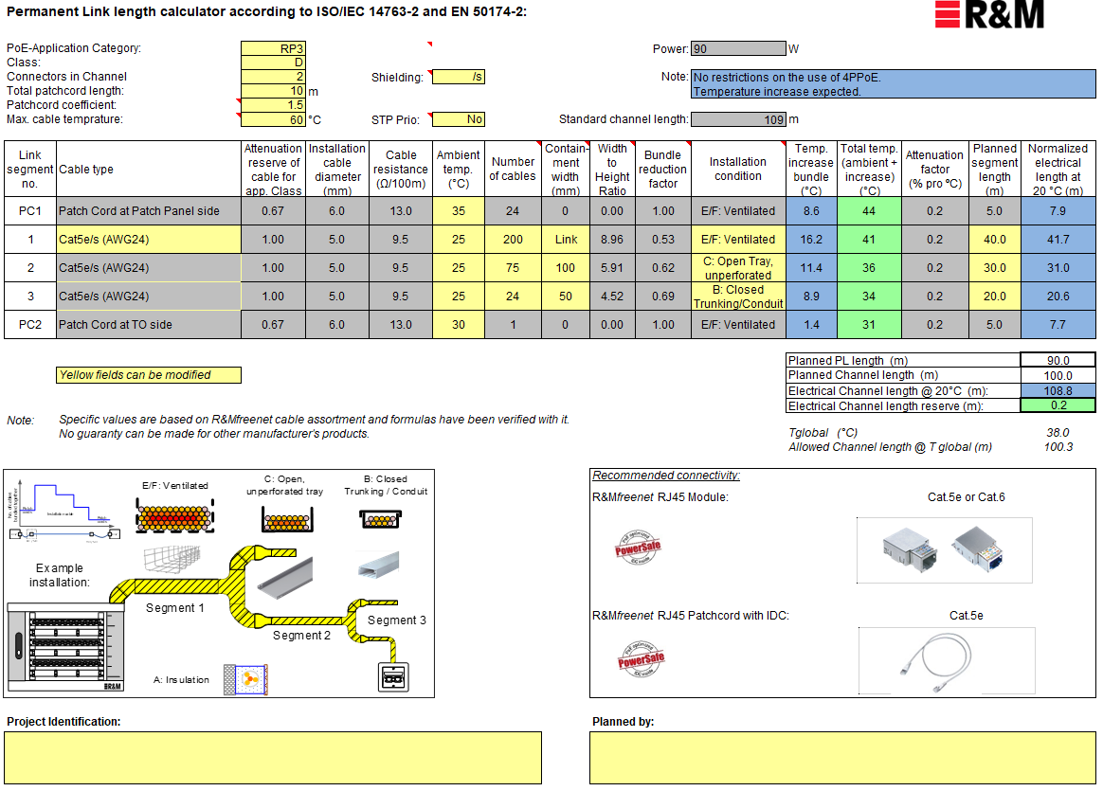
Link Length Calculator
5 main calculator parts:
Application Setup
Defines installation condition
Cabling Setup Information
Illustrates cable routing and product recommendations
Segment Setup
Specification of the conditions in the different cabling segments
Result Section
Shows calculated cabling length for worst case condition
Planning Documentation
Application Setup
Segment Setup
Result Section
Cabling Setup Information
Planning Documentation
Notes:
The individual parts are explained later

Slide 9
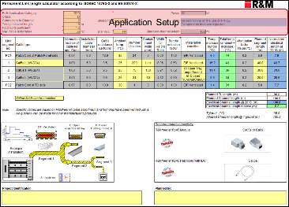
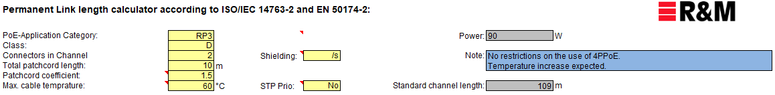
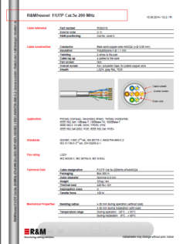
Application setup
RP Category Calculator
or
Cabling Specification
The standards do not recognize the better thermal properties of shielded cabling. This button controls whether the calculator follows reality or standards
STP:
UTP:
Notes:
This section of the calculator defines the setup of how the cabling is used.

Slide 10
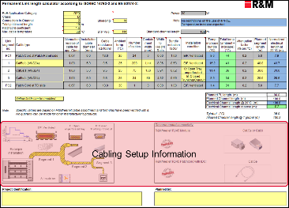
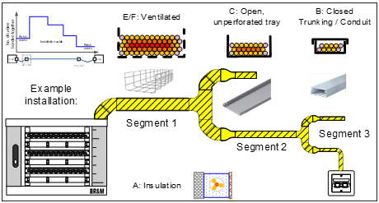
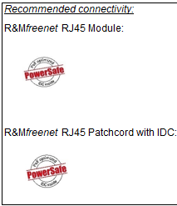
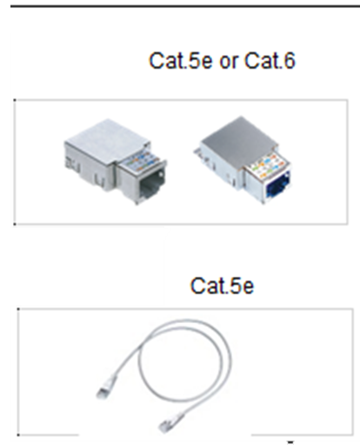
Cabling Setup Information
Cable bundle size gets smaller from Distributor side to Outlet side
Three different Permanent Link segments are possible plus two separate Patch Cord segments
Separate environmental / installation conditions for each segment
Notes:
This section gives some background information, on how to use the Segment definition section.
Three segments of a PL can be specified to simulate reality. Some abstraction must be used.

Slide 11
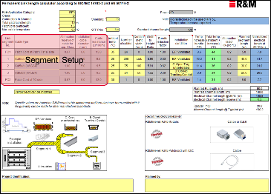
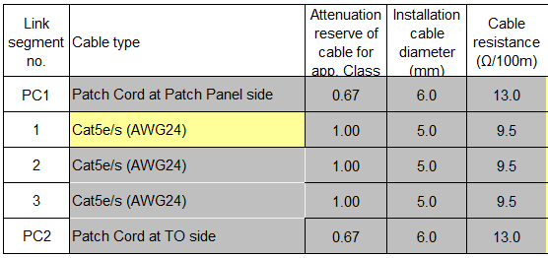
Segment definition (1)
Cable selection
STP:
UTP:
The number of different cable types possible in the PL depends on the number of connectors
Cat.5e @ Class D: 100%
Cat.6 @ Class D: 105%
Cat.6_{A} / 7 @ Class D: 110%
Cat.7_{A} @ Class D: 115%
Cat.6 @ Class E: 100%
Cat.6A / 7 @ Class E: 105%
Cat.7A @ Class E: 110%
Cat.6A / 7 @ Class EA: 100%
Cat.7_{A} @ Class EA: 105%
Note:
Specific values are based on the R&Mfreenet cable assortment and the formulas have been verified with it.
No guaranty can be made for other manufacturer's products.
PL-Segments
Notes:
Depending on selected numers of cpnnectors in the channel, the number of different cable types in the segments change
2 Connectors: 1 installation cable type
3 connectors: 1 Installation cable & 1 consolidation cable
4 connectors: 1 Installation cable & 1 consolidation cable & 1 switch Link cable
Cable selection range depend whether you choose UTP or STP cabling in the top
Cable specification for the different cable types is defined in the Preset section

Slide 12
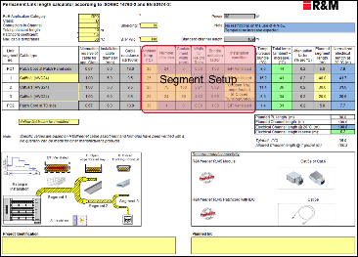
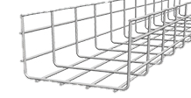
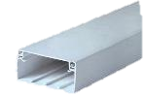
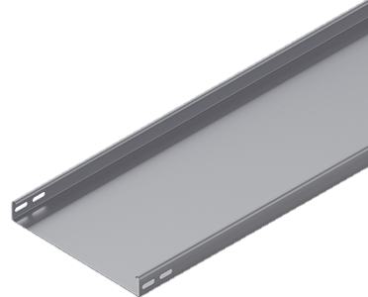
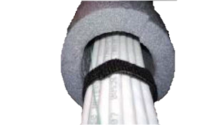
Segment definition (2)
Cable pathway description
Containment width x mm
Containment width = 0
Ambient temperature in the cabling pathway during the hottest time of the year
B
E/F
A
Factor to cover the better heat dissipation properties of a rectangular arrangement over a round bundle
C
Notes:
Ambient temperature should consider worst case
Number of cables indicates the maximum number of cables in a containment
Containment width = 0 defines a round cable bundle
Round cable bundles must be placed at least with one cable bundle diameter distance from each other

Slide 13
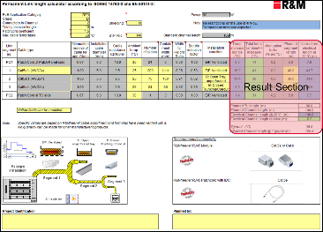
Result Section with Segment length planning
Calculated maximum wire temperature: ambient + increase
Must be below the value defined previously (green), typical 60°C
Applicable attenuation increase in the cable per 1°C temperature increase above 20°C
Planned maximum worst case segment length, valid for the entire project / installation
Calculated temperature increase due to PoE
Calculated electrical length for this cabling segment under standardized conditions @ 20°C
Lengths reserve for planned segment lengths. Positive values (green)are good, negative values (red) need a change in the setup
Total planned permanent link / channel length
Calculated average Channel temperature and allowed channel length per standard (check point)
Notes:
Defined patch cord length is distributed between panel and outlet side according to typical implementations
Normalized electrical channel length is compared to the standardized channel length for the respective transmission class.
Tglobal and Allowed Channel length at Tglobal are for information and give a sanity check for the values calculated above

Slide 14
Optimizing
1
4
2
3
Define application and cabling model (building cabling specification)
Define particulars of each segment as necessary (installation conditions)
Define planning length of segments for the project.
Repeat points 2 & 3 until “Electrical Channel length reserve” and “Total temp.” are green.
Notes:
Mitigation possibilities:
Increase wire gauge by changing to higher cable categories than strictly necessary for a given class
Reduce bundle sizes
Change containment width or containment type. Use forced ventilation.
Use shielded cabling instead of unshielded (and set STP Prio: Yes)
Reduce planned segment lengths to below 90m total

Slide 15
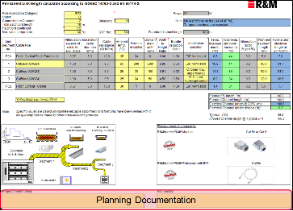
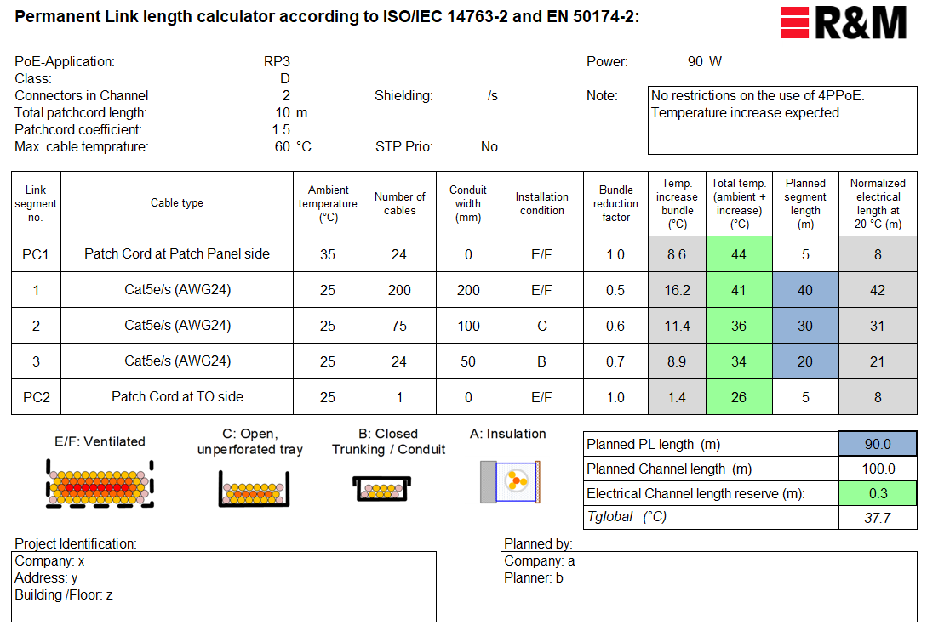
Planning Documentation & Printout
Fill out “Planned by” to make planning traceable to the responsible planner. E.g.:
Company: aaa
Planner: bbb
Fill out “Project Identification” to make planning traceable to the installation concerned. E.g.:
Company: xxx
Address: yyy
Building / Floor: zzz
Print out “Printout” section (paper or PDF) and file it with other project documentation, e.g. test data.
Use this sheet to apply for upgrade to RP2 or RP3 on R&Mfreenet warranty certificate.
Notes:
Location for which the planning applies shall be made clear
Person who dis the planning shall be made clear
The Printout section is for filing purposes, reduced to the information needed to evaluate the installation

Slide 16

Thank you !
Matthias Gerber
Market Manager LAN Cabling
matthias.gerber@rdm.com
www.rdm.com
Notes:
16

